Slide 1
Notes and additional resources for users are included in the notes section.
This content is available under a Creative Commons Attribution License. Logos are trademarks or registered trademarks of their respective organizations and may not be reused or reproduced without permission.

Slide 2
Declaration On Research Assessment Improving how research is assessed
sfdora.org
@DORAssessment
Notes:
DORA is an initiative supported by nine organizations to push for real change in research assessment. The vision of DORA is to advance practical and robust approaches to research assessment globally and across all scholarly disciplines. Individuals and organizations can sign the declaration pledging to improve culture around research evaluation. DORA is collecting best practices to help members of the community learn from each other and create change. More information is on the website: sfdora.org
Journal-based metrics are often misused and ill applied in research and researcher evaluation. This is happens at key transition points during a researcher’s career, including hiring, promotion, and tenure.

Slide 3
Why a Declaration?
Addresses misuse of journal-based metrics in hiring, promotion and funding decisions
Draws attention to the problem and fosters progressive solutions
Demonstrates community support for change
Three principles of DORA
Eliminate the use of journal-based metrics in research assessment
Assess research on its own merits
Capitalize on technology to enhance scholarly communication and evaluation of the impact of research
September 2018:
Signed by >500 organizations and >12,500 individuals
Notes:
Problems with the JIF (from the preamble to the declaration):
citation distributions within journals are highly skewed
the properties of the Journal Impact Factor are field-specific: it is a composite of multiple, highly diverse article types, including primary research papers and reviews
Journal Impact Factors can be manipulated (or “gamed”) by editorial policy
data used to calculate the Journal Impact Factors are neither transparent nor openly available to the public

Slide 4
Meaningful Assessment Improves Research
Promotes value of all scholarly outputs
Focuses on the merits of the work
Journal articles
Preprints
Datasets
Software
Protocols
Research materials
Well-trained researchers
Societal outcomes and policy changes
Reduces JIF-chasing
Facilitates Open Science practices
Improves rigor and reliability
Enhances collaboration

Slide 5
Key Recommendation
“Do not use journal-based metrics, such as Journal Impact Factors, as a surrogate measure of the quality of individual research articles, to assess an individual scientist’s contributions, or in hiring, promotion, or funding decisions.”
Plus 17 recommended commitments to stimulate positive action by:
funders
research institutions
publishers
metrics providers
researchers
Notes:
People may associate DORA with negative thinking, assuming that all the declaration says is “Don’t use JIFs”. But from the beginning DORA has been a positive enterprise, seeking to foster innovation and responsible practice in research assessment. JIFs (and journal names) are frequently misused as a shortcut because they can quickly be applied to sort large volumes of applications. It is important that alternatives to the JIF are time efficient and intuitive.

Slide 6
Recommendations for Research Institutes & Funders
State that scientific content of a paper, not the JIF of the journal where it was published is what matters
Consider value from all outputs and outcomes generated by research

Slide 7
Recommendations for Publishers
Cease to promote journals by Impact Factor; provide array of metrics
Focus on article-level metrics
Identify different author contributions
Open the bibliographic citation data
Encourage primary literature citations

Slide 8
Recommendations for Metrics Providers
Be transparent
Provide access to metrics data
Discourage data manipulation
Provide different metrics for primary literature and reviews
Notes:
Clarivate now shows citation distributions of items cited for a journal with mean/median & review compared to primary research citations.
https://clarivate.com/blog/science-research-connect/the-2018-jcr-release-is-here/

Slide 9
Recommendations for Researchers
Focus on content
Cite primary literature when you can
Use a range of metrics to show the impact of your work
Change the culture!

Slide 10
Milestones for DORA and Other Initiatives
Time
2012
2013
2015
2017
2018
Idea for DORA born from community discussions
Declaration on Research Assessment published
Leiden Manifesto and the Metric Tide Report Published
EU publishes recommendations to recognizes open science in researcher evaluation
DORA website, steering committee
and roadmap launched
Notes:
The idea for DORA came from the 2012 Annual Meeting for the American Society for Cell Biology in San Francisco; but DORA’s ambitions extend across all disciplines.
DORA is working collaboratively with those involved in other initiatives and happy to work with partners

Slide 11
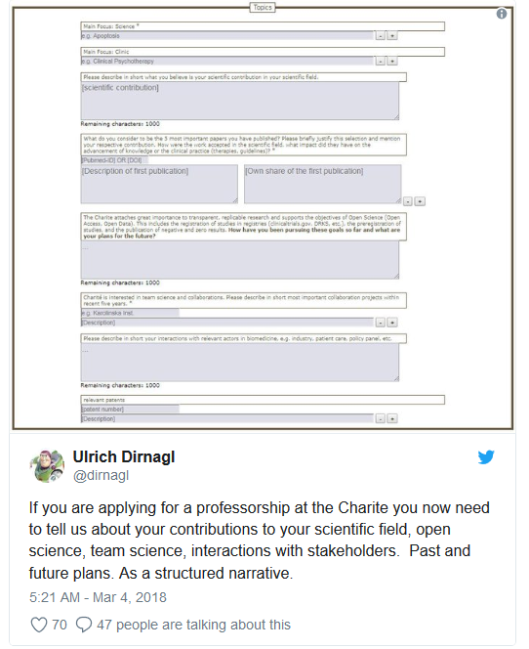
Change is happening: Research Institutes
Application includes:
Contribution to research field
Open Science
Team Science
Interactions with stakeholders
Staff member sits on hiring deliberation meetings as a neutral party to promote balanced discussions
UT Southwestern Medical Center
Dallas, Texas
Candidates receive questions before Skype interviews, so they have time to reflect. The goal is to identify thoughtful individuals, in addition to candidates who process information quickly.
Charité University Hospital
Berlin, Germany
Notes:
UT Southwestern example: https://sfdora.org/2018/05/15/how-to-strengthen-hiring-practices-at-academic-institutions-an-interview-with-dr-sandra-schmid/
Charité University Hospital: https://sfdora.org/2018/07/06/simple-questions-big-insights-charite-uses-bio-sketch-questions-to-recruit-faculty/

Slide 12
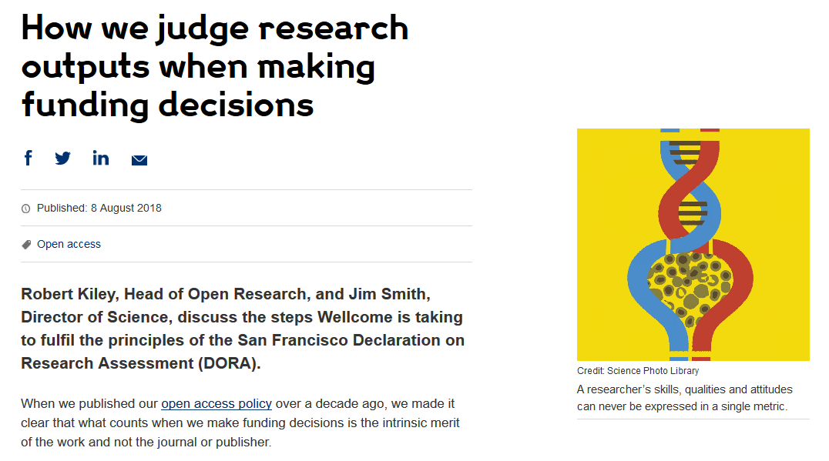
Change is happening: Funders
Cancer Research UK
London, UK
Application includes:
List of research outputs
Summary of 3-5 achievements
Space to describe other measures of impact
Reminds peer reviewers and committee members of DORA principles throughout funding process
Wellcome
London, United Kingdom
Application includes:
List of research outputs
Contributions to mentorship
Output sharing plan to advance potential health benefits
Plans for public engagement
Guidance provided to advisory panel members
Notes:
Wellcome example: https://wellcome.ac.uk/news/how-we-judge-research-outputs-when-making-funding-decisions
Cancer Research UK example: https://www.cancerresearchuk.org/funding-for-researchers/research-features/2018-02-20-improving-research-evaluation-dora

Slide 13
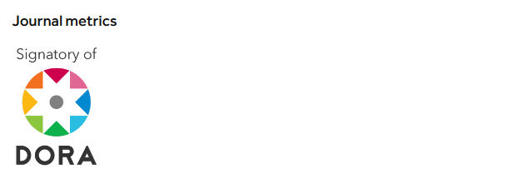
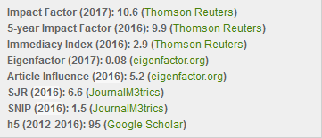
Change is happening: Publishers
PLOS
San Francisco, California
Dedicated page on website describing how its journals comply with DORA recommendations
The Company of Biologists
Cambridge, UK
EMBO Press
Heidelberg, Germany
“Development uses a number of metrics that together provide a rich view of the journal’s performance”
Acknowledges DORA signature
Shows citation distributions for its journals
Presents all available metrics side-by-side and rounded to single digits
Notes:
PLOS example: https://www.plos.org/dora
Company of Biologists example: http://dev.biologists.org/content/about
EMBO examples: http://emboj.embopress.org/about#bibliometrics; http://emboj.embopress.org/content/34/12/1601

Slide 14
Roadmap: DORA is a living document
Research assessment should focus on the most desirable qualities of research – insight, impact, reliability and re-usability
DORA will:
Increase awareness of the need to develop alternatives to the JIF
Research and promote best practice in research assessment.
Extend the global and disciplinary impact of DORA
Notes:
DORA roadmap: https://sfdora.org/2018/06/27/dora-roadmap-a-two-year-strategic-plan-for-advancing-global-research-assessment-reform-at-the-institutional-national-and-funder-level/

Slide 15
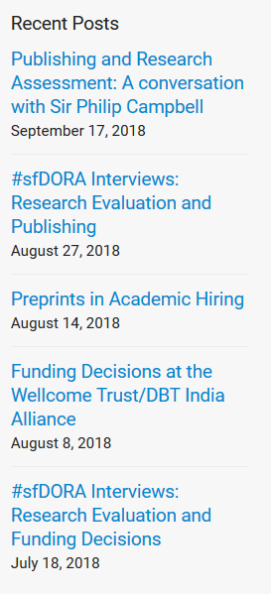
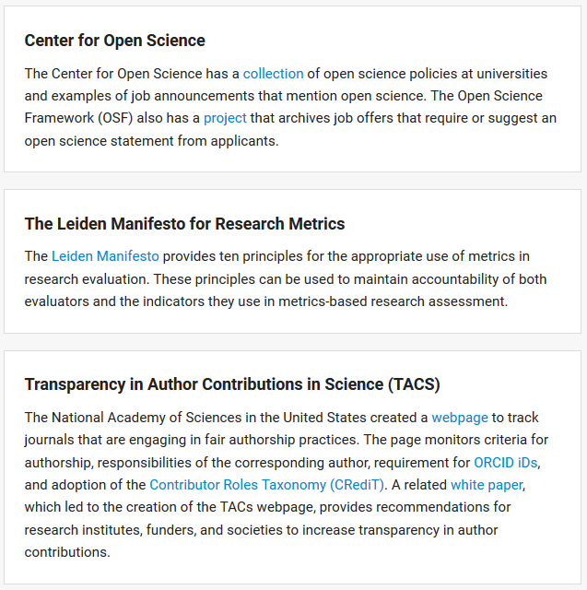
DORA Roadmap Progress
Blog
Good practices
Interview series
Translations of DORA
Declaración De San Francisco Sobre La Evaluación De La Investigación
San Francisco Vereinbarung über die Forschungsbewertung
Sanfranciská deklarácia hodnotenia vedeckého výskumu
Notes:
DORA interviews:
Sandra Schmid (UT Southwestern): https://sfdora.org/2018/05/15/how-to-strengthen-hiring-practices-at-academic-institutions-an-interview-with-dr-sandra-schmid/
Shahid Jameel (Wellcome Trust/DBT India Alliance): https://sfdora.org/2018/08/08/funding-decisions-at-the-wellcome-trust-dbt-india-alliance/
Sir Philip Campbell (Springer Nature): https://sfdora.org/2018/09/17/publishing-and-research-assessment-a-conversation-with-sir-philip-campbell/
Good Practices: https://sfdora.org/good-practices/funders/
Translations: DORA has been translated into German, Dutch, French, Slovak, Italian, and Spanish. https://sfdora.org/read/es/
Blog: https://sfdora.org/blog/

Slide 16
What can you do?
Sign DORA
Ask your institution/employer to review assessment practices
Use our collection of good practices to implement change
Tell us about how you improved assessment so we can share your ideas with others

Slide 17
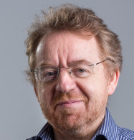
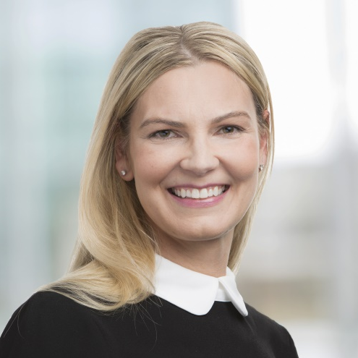
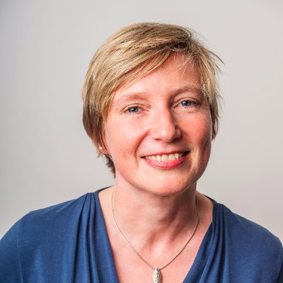
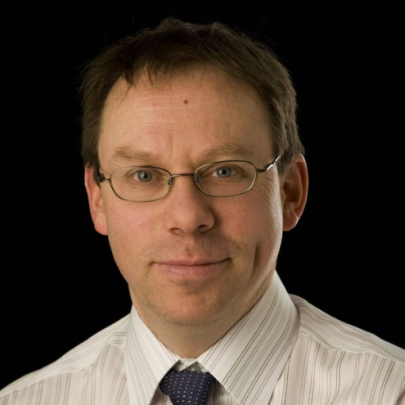
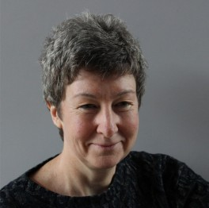
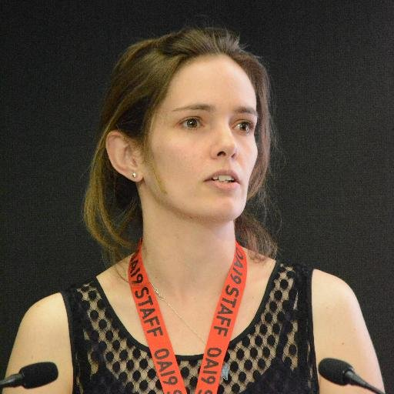
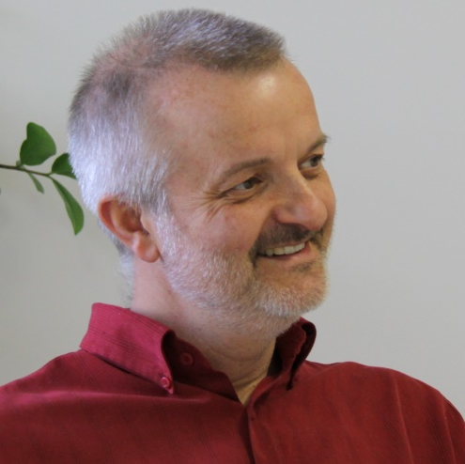
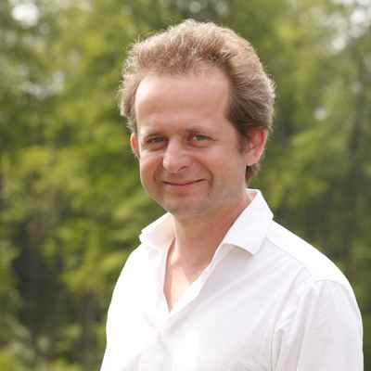
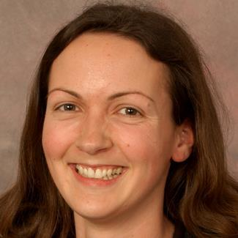
Supporting organizations, Steering Committee and Staff
Stephen Curry, Chair
Imperial College London
Jennifer Hansen
Bill and Melinda Gates Foundation
Veronique Kiermer
PLOS
Robert Kiley
Wellcome
Anna Hatch
DORA Community Manager
Catriona MacCallum
Hindawi
Erin McKiernan
National Autonomous University of Mexico
Claire Moulton
Company of Biologists
Mark Patterson
eLife
Bernd Pulverer
EMBO
Fiona Reddington
Cancer Research UK
Erika Shugart
American Society for Cell Biology

Slide 18
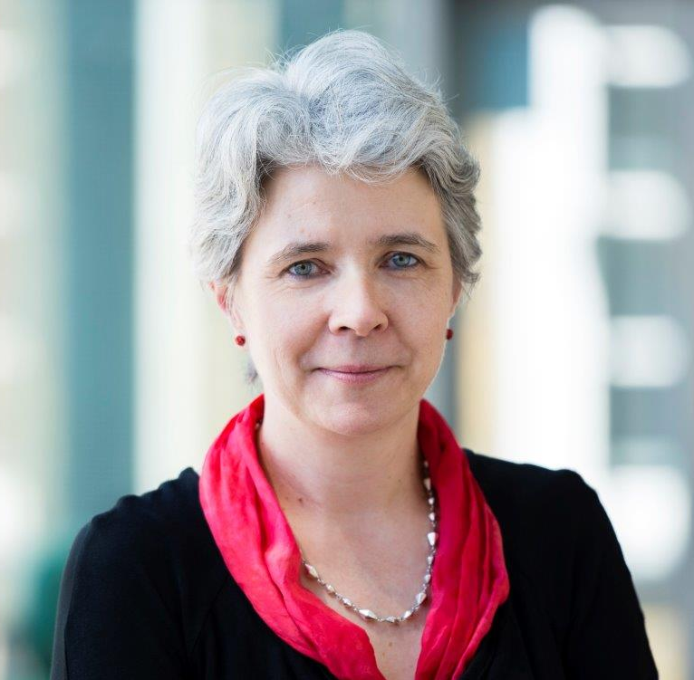
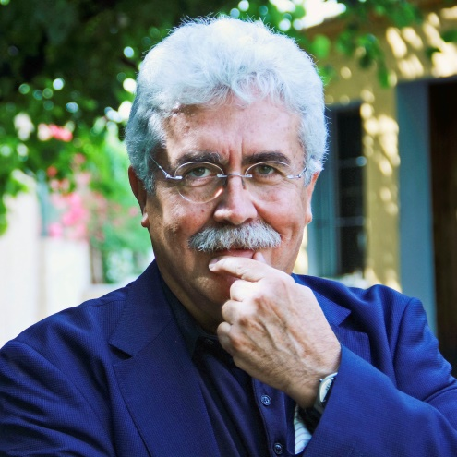
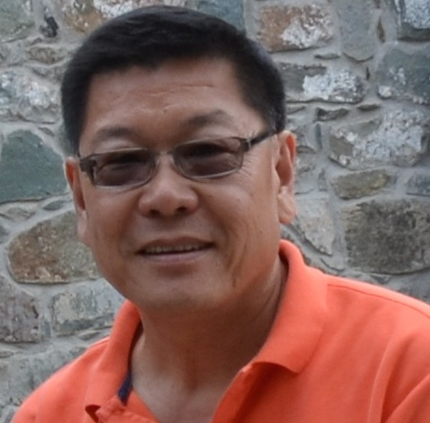
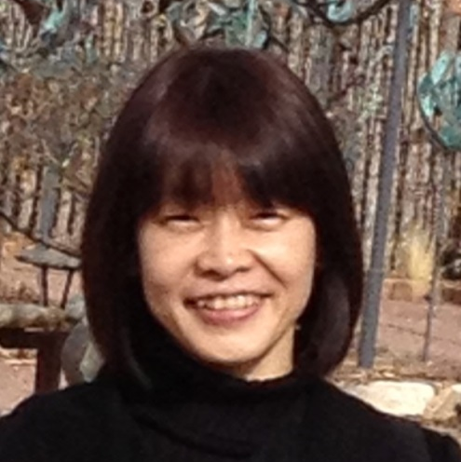
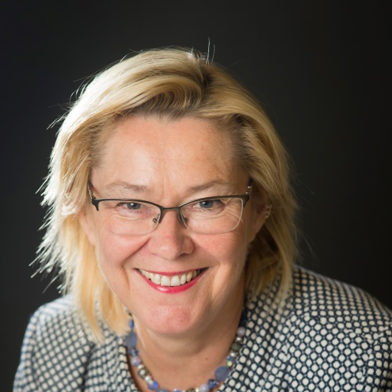
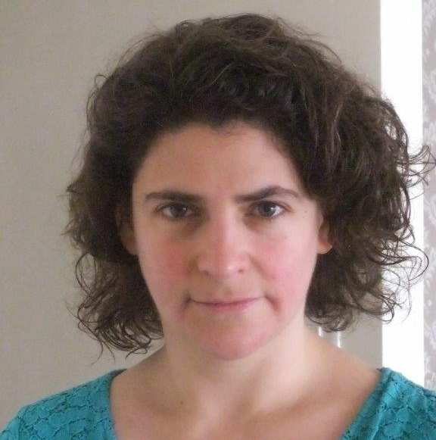
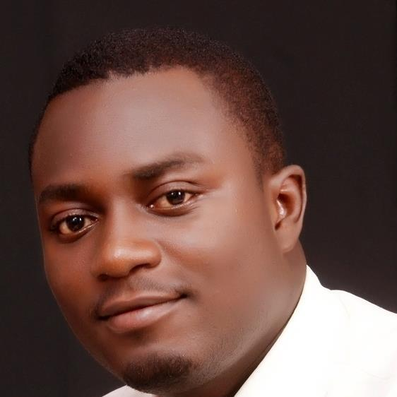
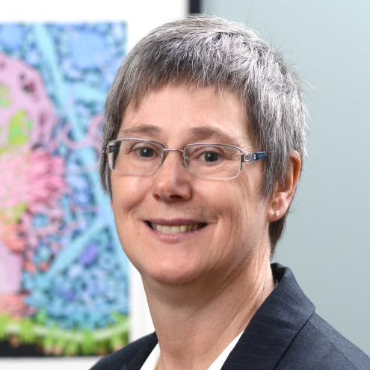
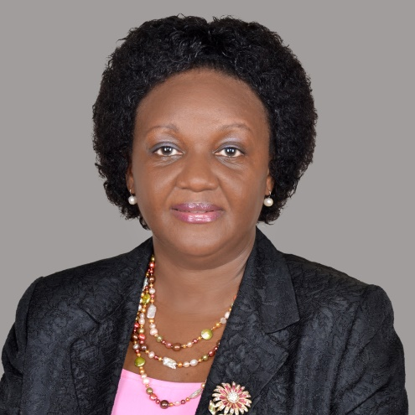
Advisory Board
Dominique Babini
CLACSO
Argentina
Ginny Barbour
Queensland University of Technology
Australia
José Pío Beltrán
CSIC
Spain
Leslie Chan
University of Toronto Scarborough
Canada
David Drubin
University of California Berkeley
United States
Christian Gonzalez-Billaut
Universidad de Chile
Chile
Yukiko Gotoh
The University of Tokyo
Japan
Kristiina Hormia-Poutanen
National Library of Finland
Finland
Rebecca Lawrence
F1000
United Kingdom
Xiaoxuan Li
Chinese Academy of Sciences
China
Satyajit Mayor
National Centre for
Biological
Science (TIFR)
India
Valerie Mizrahi
University of Capetown
South Africa
Ahmed Ogunlaja
Open Access Nigeria
Nigeria
Sandra Schmid
UT Southwestern Medical Center
United States
Iara Vidal
Federal University
of Rio De Janeiro
Brazil
Rhoda Wanyenze
Makerere University School
of Public Health
Uganda

